Slide 1

Launch Webinar
Tuesday, October 20, 2026 | disabilityinresearch.org
NIH · Administered by Floor23 Digital

Slide 2

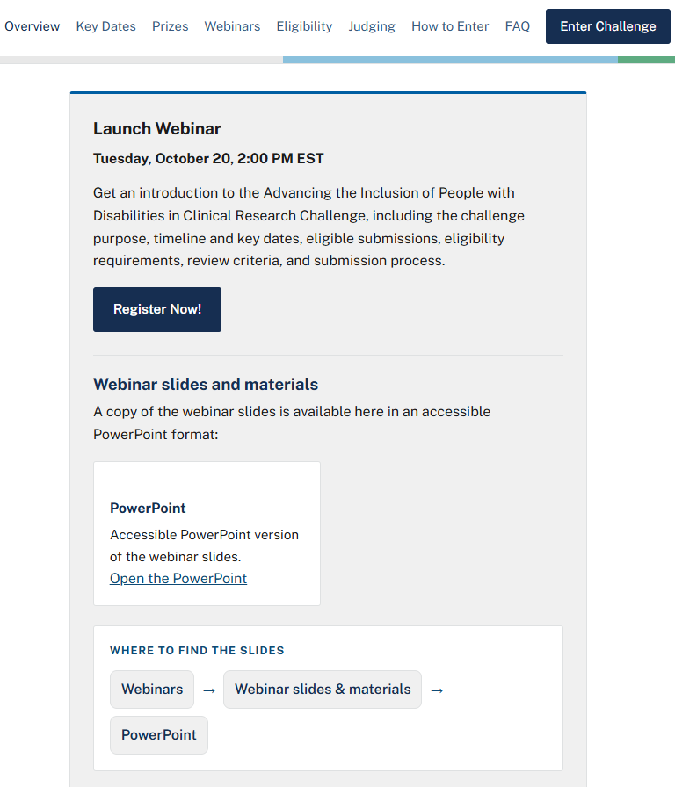






Before we begin: recording and slides
Click in Webinars
Recording will be posted with captions within 48 hours.
Slide deck in PPT format available now
Visit our website disabilityinresearch.org
Advancing the Inclusion of People with Disabilities in Clinical Research Challenge
2
Notes:
Be sure the Alte text is updated with this updated screenshot

Slide 3
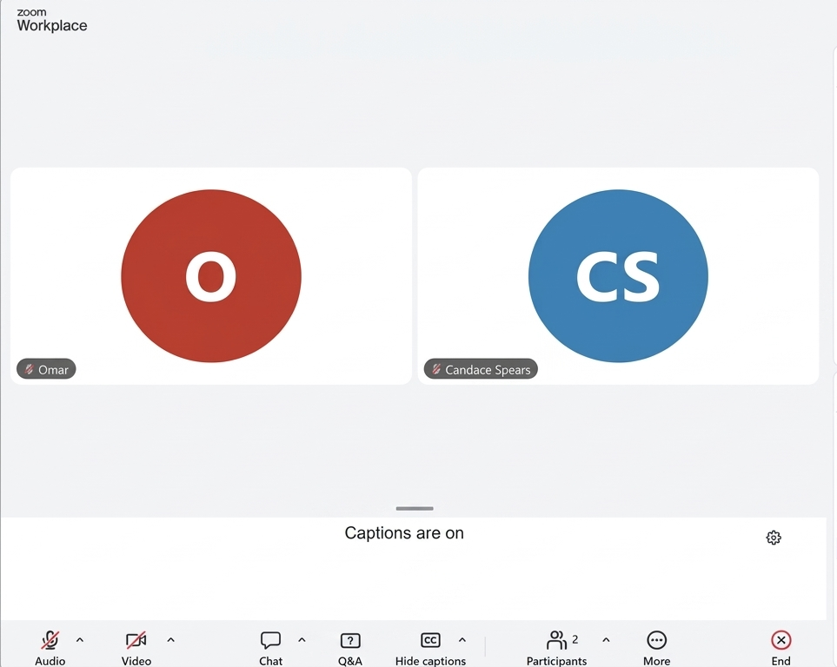









Before we begin: ASL and captions
ASL: Interpreters are spotlighted on screen for the whole session, so everyone can see them
Captions: A professional CART captioner provides real-time captions throughout the session. They appear at the bottom.
Prefer your browser? You may also access captions by visiting: streamtext.net/player?event=NIH
Advancing the Inclusion of People with Disabilities in Clinical Research Challenge
3

Slide 4
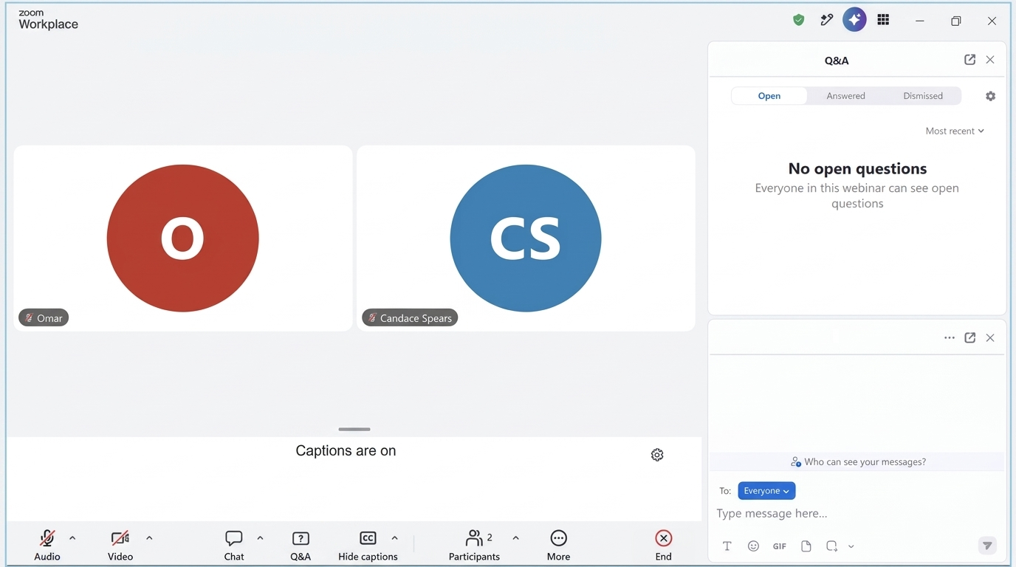




Your questions
Questions? - Type it in the question box.
No answer today? Questions we cannot get to today will be answered and posted publicly to the challenge Q&A.
Advancing the Inclusion of People with Disabilities in Clinical Research Challenge
4
Notes:
Can get rid of the “1” next to Click Q&A to be consistent with the other slides. The highlighted box for questions…is that the space where you type the question, or just to see the question that have been entered? Be sure the alt text is updated accordingly for any updated screenshot.

Slide 5
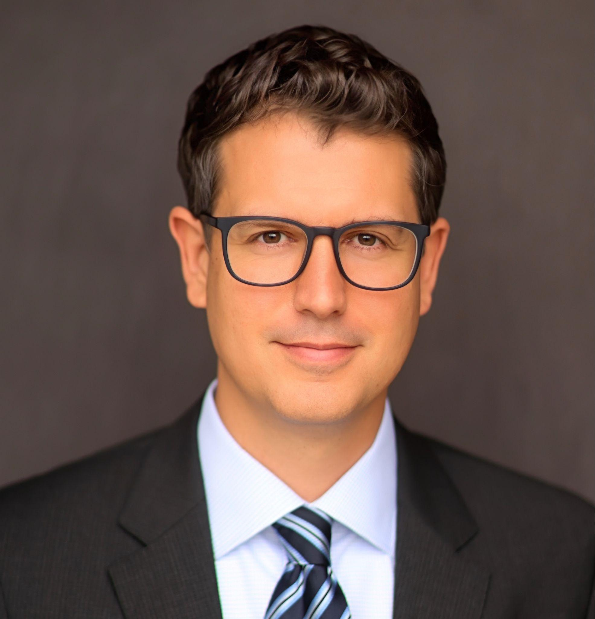
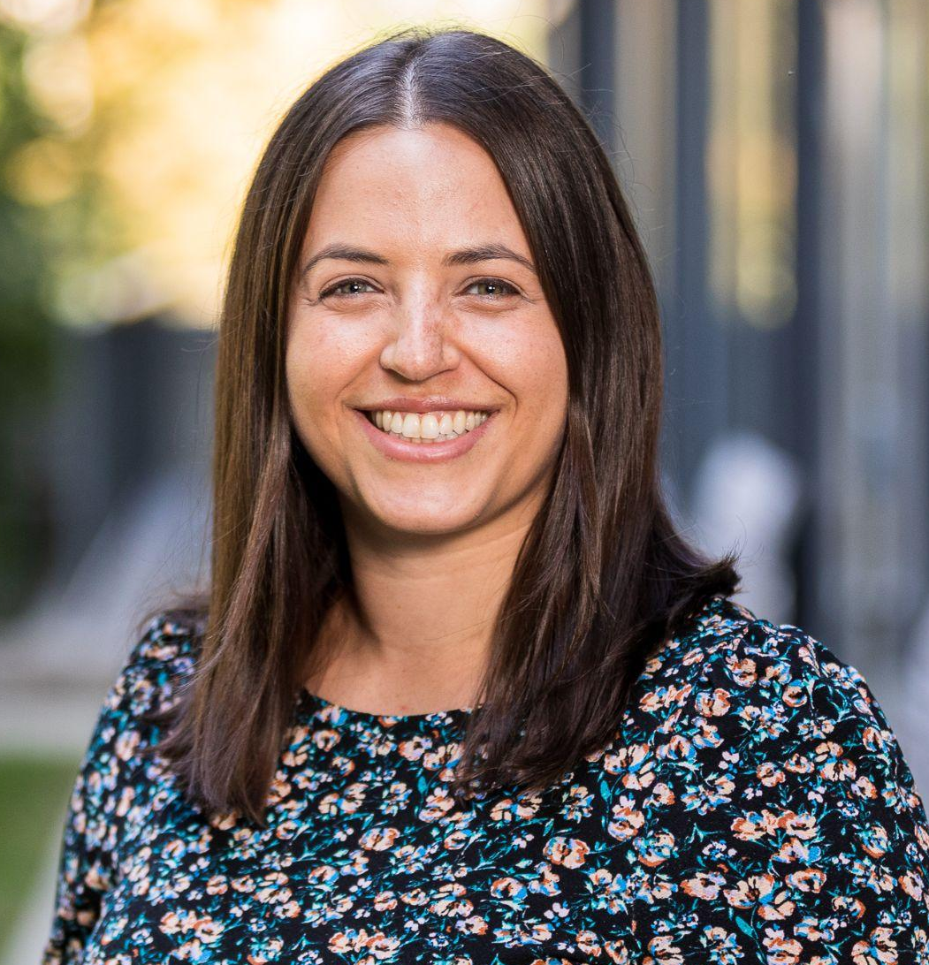

Today's presenters
Adam Politis
Dr. Rachelle Brick
Candace Spears
Director, Disability Health Research Program, NIH Office of the Director
Program Director, Healthcare Delivery Research Program, National Cancer Institute, NIH
Founder and CEO, Floor23 Digital, Challenge Administrator
Advancing the Inclusion of People with Disabilities in Clinical Research Challenge
5

Slide 6
Agenda
1. Why this Challenge
2. What NIH is looking for
3. Prizes
4. Key dates
5. Who can participate
6. What to submit
7. How submissions are evaluated
8. How to enter
9. Support and resources
10. Your questions
Advancing the Inclusion of People with Disabilities in Clinical Research Challenge
6

Slide 7
Why this challenge
Yet people with disabilities are often excluded from clinical research without adequate scientific justification:
More than
1 in 4
Explicitly, unnecessarily restrictive eligibility criteria
Implicitly, inaccessible procedures and incorrect assumptions about capacity to consent
people in the United States has a disability*
*Source: Centers for Disease Control and Prevention, July 16, 2024.
Exclusion undermines the generalizability of findings and keeps people with disabilities from the benefits of research.
Advancing the Inclusion of People with Disabilities in Clinical Research Challenge
7

Slide 8


Inclusion strengthens research
More representative evidence
People with disabilities experience many of the conditions under study, often at higher rates.
Real-world safety and efficacy data
Captured across variation in function, comorbidity, and medication use, before interventions reach clinical practice.
Better studies for all participants
Accessibility practices such as plain language consent and flexible procedures tend to improve comprehension, participation, and data quality.
Advancing the Inclusion of People with Disabilities in Clinical Research Challenge
8

Slide 9
NIH's commitment
Inclusion involves more than enrollment. Exemplary approaches:
The NIH Strategic Plan for Disability Health Research FY26–FY30 identifies the inclusion of people with disabilities in research as a crosscutting theme.
account for the needs, experiences, and perspectives of people with disabilities at every stage of a study.
are developed in partnership with people with disabilities, their families, and their care partners
ensure that people with disabilities can use reasonable accommodations
This Challenge is led by DPCPSI's Disability Health Research Program in partnership with NCI, NICHD, NIDA, NIDCD, NIMHD, NINR, and the NIH Office of Disease Prevention.
Advancing the Inclusion of People with Disabilities in Clinical Research Challenge
9

Slide 10
What NIH is looking for
The goal: identify, recognize, and disseminate exemplary approaches to promoting the inclusion of people with disabilities in clinical research.
What winners receive beyond the prize
Winners will have their materials publicly disseminated by NIH as models for investigators, institutions, sponsors, and institutional review boards.
Submissions should include documents suitable for public dissemination:
best practice resources
study protocols
standard operating procedures
toolkits
training materials
Advancing the Inclusion of People with Disabilities in Clinical Research Challenge
10

Slide 11
Approaches you can submit
Barriers an approach might address:
Stages of a study where an approach can act:
restrictive eligibility criteria
inaccessible study sites or materials
informed consent
reasonable accommodations
communication access
planning and design
recruitment and enrollment
conduct of the research
communication of results
Submissions are invited from academia, industry, not-for-profits, professional societies, patient advocacy groups, community organizations, and others.
Advancing the Inclusion of People with Disabilities in Clinical Research Challenge
11

Slide 12
Prizes
Payment: by electronic funds transfer; may be subject to federal income taxes.
Total prize purse:
$1,000,000
Teams: the Team Leader is paid the full prize.
Entities: the prize is paid directly to the Entity. A free Unique Entity ID (UEI) from SAM.gov is encouraged, not required, and speeds up payment.
NIH anticipates up to 20 winners of $50,000 each.
Advancing the Inclusion of People with Disabilities in Clinical Research Challenge
12

Slide 13
What to submit
1. Title and Executive Summary
1 page*
2. Description of the approach
How the approach advances the inclusion of people with disabilities in clinical research and addresses the Review Criteria 2 to 3 pages*
3. Public Dissemination Materials
Documents that educate or implement the approach, such as best practice resources, study protocols, standard operating procedures, toolkits, and training materials.
No page limit*
Participants must submit all of the above to be considered for a prize.
All submissions must be in English and Section 508 conformant. Participants must not use the HHS logo, official seal, or the logo of NIH in their submissions and must not claim federal government endorsement.
*These are page equivalents. A character-restricted form is used for submission, where appropriate.
Advancing the Inclusion of People with Disabilities in Clinical Research Challenge
13

Slide 14

How submissions are evaluated
1
2
3
Review Panel:
Judging Panel:
Award Approving Official:
Individuals with subject matter expertise in disability health research individually evaluate each submission, rating each criterion on a five-point scale from "not at all" to "completely". Ratings are combined into a score for each submission.
Federal employees from NIH, and potentially other agencies, receive the scores and select the winners.
The Director of DPCPSI gives final award decision approval.
Advancing the Inclusion of People with Disabilities in Clinical Research Challenge
14

Slide 15
The five review criteria (1 of 2)
Review Criterion | Points out of 100 | Description
Completeness and Clarity of the Submission | 16 points | Clearly and fully describes the approach: goals, barriers addressed, methods, context, and populations reached.
Relevance to Disability Inclusion in Clinical Research | 28 points | Directly and substantively addresses recognized barriers to including people with disabilities in clinical research.
Meaningful Engagement of People with Disabilities | 24 points | People with lived experience of disability helped design, implement, or govern the approach, which reflects a range of disability types.
Advancing the Inclusion of People with Disabilities in Clinical Research Challenge
15
Notes:
Check the table on this one because it is not showing in the reading order here. Check this slide when listening via a screen reader to see if the table’s contents are being read.

Slide 16
The five review criteria (2 of 2)
Review Criterion | Points out of 100 | Description
Demonstrated Effectiveness and Impact | 16 points | Evidence that the approach was implemented and improved the inclusion of people with disabilities in research.
Potential for Dissemination, Adaptation, and Sustainability | 16 points | Others can adopt, adapt, scale, and sustain the approach, with supporting resources or tools.
Total: 100 points. The full criteria text is in the Official Rules and under Judging on disabilityinresearch.org.
Advancing the Inclusion of People with Disabilities in Clinical Research Challenge
16

Slide 17
Key dates
September 28, 2026:
January 5, 2027, 5:00 PM ET :
January 15, 2027, 5:00 PM ET:
January 20 to February 26, 2027:
March 25, 2027:
Winners announced
Submission portal open
Submit by this date to be guaranteed administrative review feedback
Submission deadline
Judging period
Office hours: Thursday, November 12, 2026, 12:00 PM ET, and Wednesday, December 2, 2026, 12:00 PM ET. Registration and details on disabilityinresearch.org.
Advancing the Inclusion of People with Disabilities in Clinical Research Challenge
17

Slide 18



Rolling administrative review
Submit early
By January 5, 2027, 5:00 PM ET
Get feedback
Within 5 business days: missing items, eligibility questions, or accessibility issues
Correct and resubmit
By January 15, 2027, 5:00 PM ET
This review checks eligibility, completeness, and Section 508 accessibility. It does not assess merit or affect scoring.
Entries received after January 5 are accepted but reviewed as submitted.
Advancing the Inclusion of People with Disabilities in Clinical Research Challenge
18

Slide 19



Who can participate
Individuals
U.S. citizens or permanent residents.
Teams
The Team Leader registers, submits, and must be a U.S. citizen or permanent resident. Non-U.S. citizens and non-permanent residents can join as members but are not eligible for a cash prize; their participation may be recognized.
Entities
Incorporated in and maintaining a primary place of business in the US. Registers through a Point of Contact.
Advancing the Inclusion of People with Disabilities in Clinical Research Challenge
19

Slide 20
Eligibility limits and funding rule
Not eligible to win
Federal entities, and federal employees acting within the scope of their employment
HHS employees acting in their personal capacity
Judges of the Challenge, anyone involved in its design, production, execution, or distribution, and their immediate family
Employees of other federal agencies: check with your agency ethics official whether you can accept a prize.
Funding rule
Federal funds from a grant, cooperative agreement, or contract may not be used to develop or support a submission.
Advancing the Inclusion of People with Disabilities in Clinical Research Challenge
20

Slide 21

How to enter: getting started
1
Go to disabilityinresearch.org and open the registration and submission portal.
2
Enter your name and email, agree to the Official Rules, and click Participate.
3
Verify your email from the message you receive (check your spam folder if it does not arrive).
4
Complete your profile: Individual, Team, or Entity. Teams and Entities provide the name, affiliation, and contact information of all individuals competing.
Advancing the Inclusion of People with Disabilities in Clinical Research Challenge
21

Slide 22
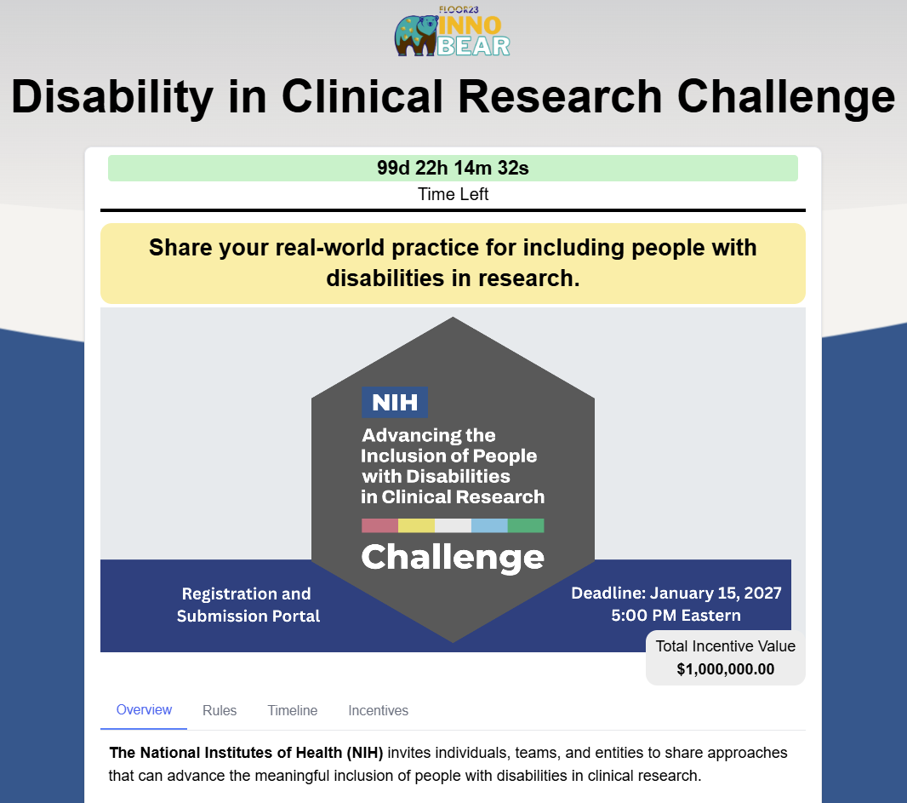
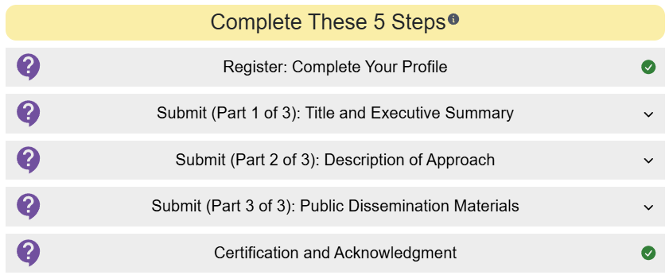
How to enter: The five steps in the portal
Register: Complete your profile
Submit (Part 1 of 3): Title and Executive Summary
Submit (Part 2 of 3): Description of Approach
Submit (Part 3 of 3): Public Dissemination Materials
Certification and Acknowledgment
A green check mark appears when a step is complete. You may edit and resubmit your entry as many times as you wish until the deadline; the most recent version is the one that will be considered.
Advancing the Inclusion of People with Disabilities in Clinical Research Challenge
22

Slide 23


Making your materials accessible
Guidance
accessible documents, PDFs, and presentations at section508.gov/create
Need help?
For any accommodation or assistance to complete or correct your submission, email disabilityinresearch@floor23digital.com
Advancing the Inclusion of People with Disabilities in Clinical Research Challenge
23

Slide 24


Support and resources (1 of 2)
Website: disabilityinresearch.org (Official Rules, FAQ, key dates, this recording and these slides)
Frequently asked questions: Updated as questions come in, including team changes, eligibility, and prizes
Email: disabilityinresearch@floor23digital.com
Official announcement: nih.gov/challenges
Advancing the Inclusion of People with Disabilities in Clinical Research Challenge
24

Slide 25
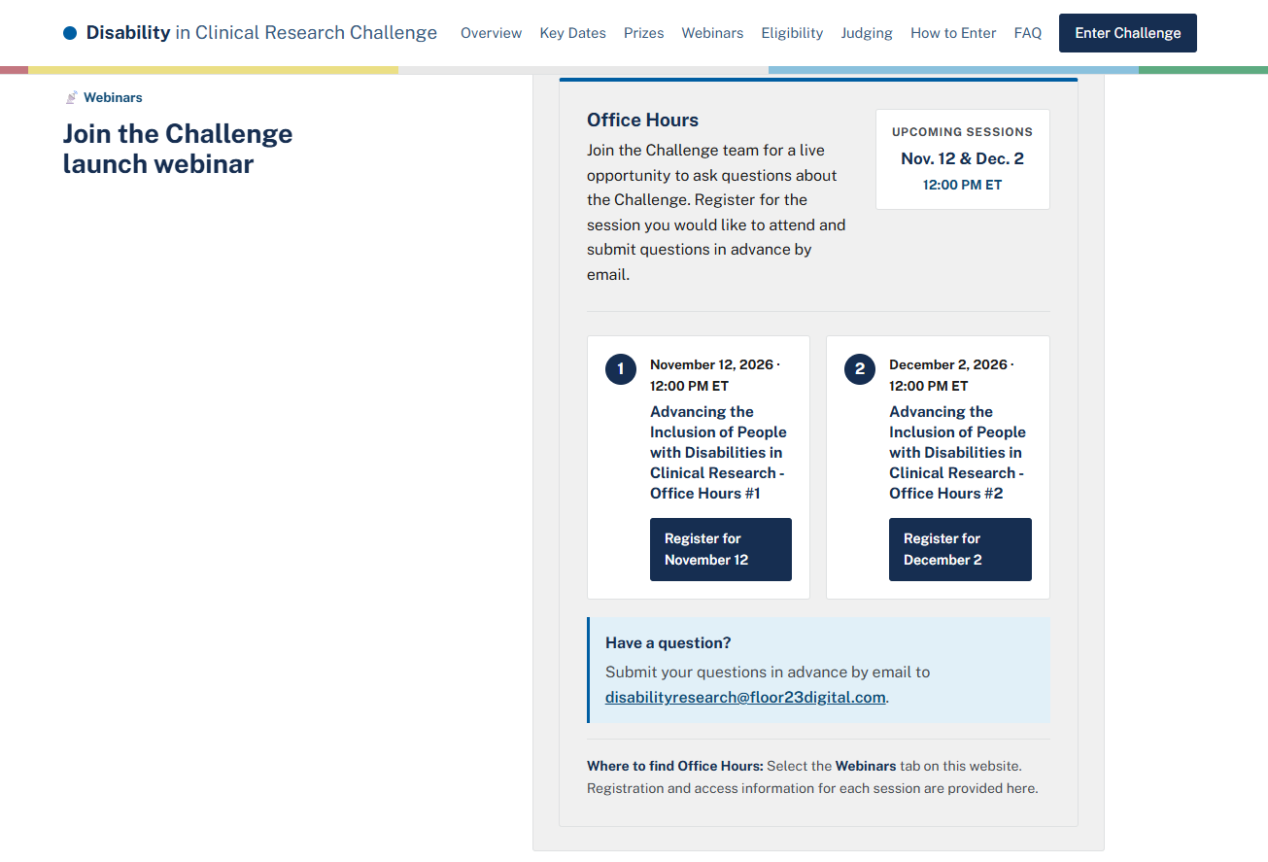

Support and resources (2 of 2)
0
Office hours: November 12 and December 2, 2026, 12:00 PM ET. Register on disabilityinresearch.org.
Click “Webinars” at the top of the screen (0)
Advancing the Inclusion of People with Disabilities in Clinical Research Challenge
25

Slide 26
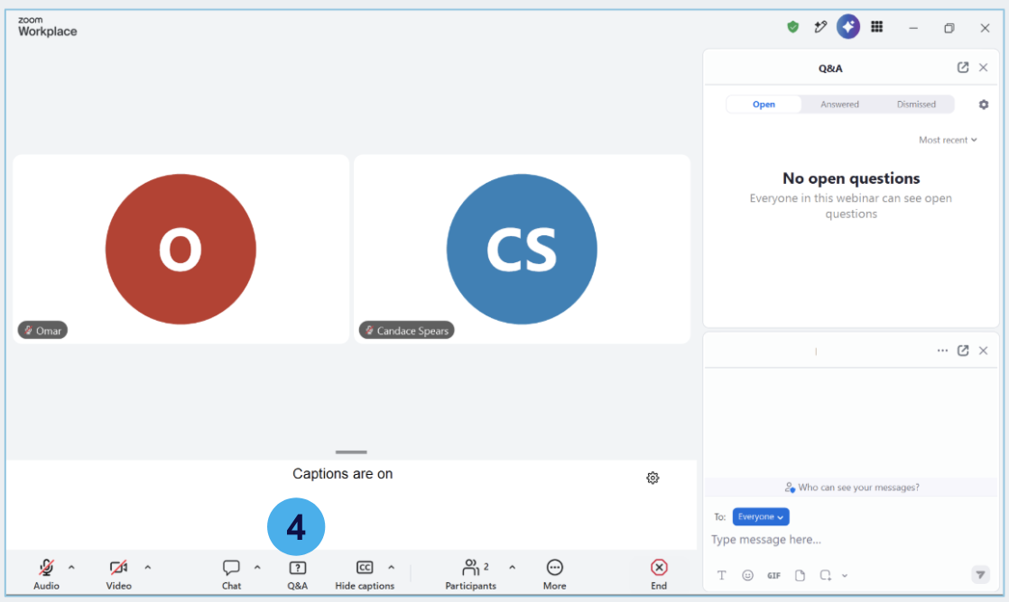
Your questions
Questions: Click Q&A and type your question in the question box. We will answer as many as we can. Questions we cannot get to today will be answered and posted publicly to the challenge Q&A (4).
Advancing the Inclusion of People with Disabilities in Clinical Research Challenge
26

Slide 27
Thank you
Submission deadline: January 15, 2027, 5:00 PM ET
disabilityinresearch.org
disabilityinresearch@floor23digital.com
Recording and slides posted within 48 hours
NIH · Administered by Floor23 Digital

